Slide 1
Cardiac Emergency Response Plan for Schools
Mary M. Newman, MS
Sudden Cardiac Arrest Foundation

Slide 2
Presenter Disclosure Information
Mary M. Newman, MS
Sudden Cardiac Arrest Foundation
Cardiac Emergency Response Plan for Schools
FINANCIAL DISCLOSURE:
No relevant financial relationship(s) exist.
UNLABELED/UNAPPROVED USES DISCLOSURE:
None

Slide 3
2015 CERP Task Force Convened by AHA
American Association of School Administrators: Dr. Sarah Jerome
American Heart Association: Douglas Dunsavage, Emily Gardner, Madeleine Konig, Denise Miles, Sarah Poole, Jeffrey Ranous, Dr. Amber Rodriguez, Dr. Comilla Sasson, Colby Tiner, Laurie Whitsel
C.S. Mott Children’s Hospital, University of Michigan Health System: Dr. Monica Goble, Gwen Fosse
The Kimberly Anne Gillary Foundation: Randy Gillary
Michigan Department of Health and Human Services: Kristina Dawkins, Maria Willoughby‐Byrwa
National Athletic Trainers’ Association: Ron Courson
National Association of School Nurses: Kathleen Rose
Parent Heart Watch: Martha Lopez‐Anderson
Project ADAM: Allison Thompson
SHAPE America: Joe Halowich
Sudden Cardiac Arrest Foundation: Mary Newman
University of California, Davis/American Academy of Pediatrics: Dr. Stuart Berger
Sarver Heart Center/American College of Cardiology: Dr. Julia Indik

Slide 4
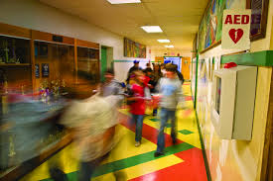
What is a Cardiac Emergency Response Plan (CERP)?
A CERP is a written document that establishes the following steps to take during a cardiac emergency in a school setting:
Establish effective communications system
Train anticipated responders in CPR and AED use
Deploy AEDs
Coordinate with local EMS system
Practice and review plan.

Slide 5
Why is a CERP Important?
SCA affects 326,200 people outside hospitals each year, including 6,328 youth <18 years old annually.¹
At any point in time, 20% of the U.S. population is in a school setting.
Prompt action by bystanders during the first few minutes of a cardiac emergency can double or triple a victim’s chance of survival.
¹ 2015 AHA Heart & Stroke Statistics

Slide 6
Developing a Cardiac Emergency Response Team
Who
Staff members with CPR/AED training
School nurse
School administrators
Health and physical education teachers
Athletic director and athletic trainers
Coaches and after school event advisors
Roles
Communicate with school administration annually on CERP
Read CERP to implement action steps
Meet monthly to evaluate CERP
Action Step Categories
AEDs
Activation of team
Communication of plan throughout school
Training plan for AED use and CPR
Integration with EMS
Annual review and plan evaluation
Protocol for all responders

Slide 7
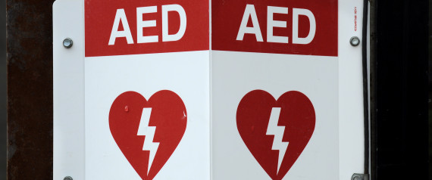
AED Placement
Number of AEDs should be sufficient to enable response team to retrieve AED and deliver it to victim’s side within 2 minutes of notification, both inside school and any location on school grounds.
One or more AEDs should be available to replace any AED that is out of service and should also be available for use by teams and other school groups traveling to off-site locations.

Slide 8
AED Placement
AEDs should have clear signage.
AEDs should never be locked in office or stored in location that is not easily accessible at all times.
AEDs should be readily accessible during school day and during after-school activities.

Slide 9
AED Maintenance and Readiness
School should regularly check and maintain every AED in accordance with manufacturers’ operating manual, and maintain log of maintenance activities.
School should designate person who will be responsible for verifying AED readiness.
Resuscitation kit should include latex-free gloves, razor, scissors, antiseptic wipes, CPR barrier mask.

Slide 10
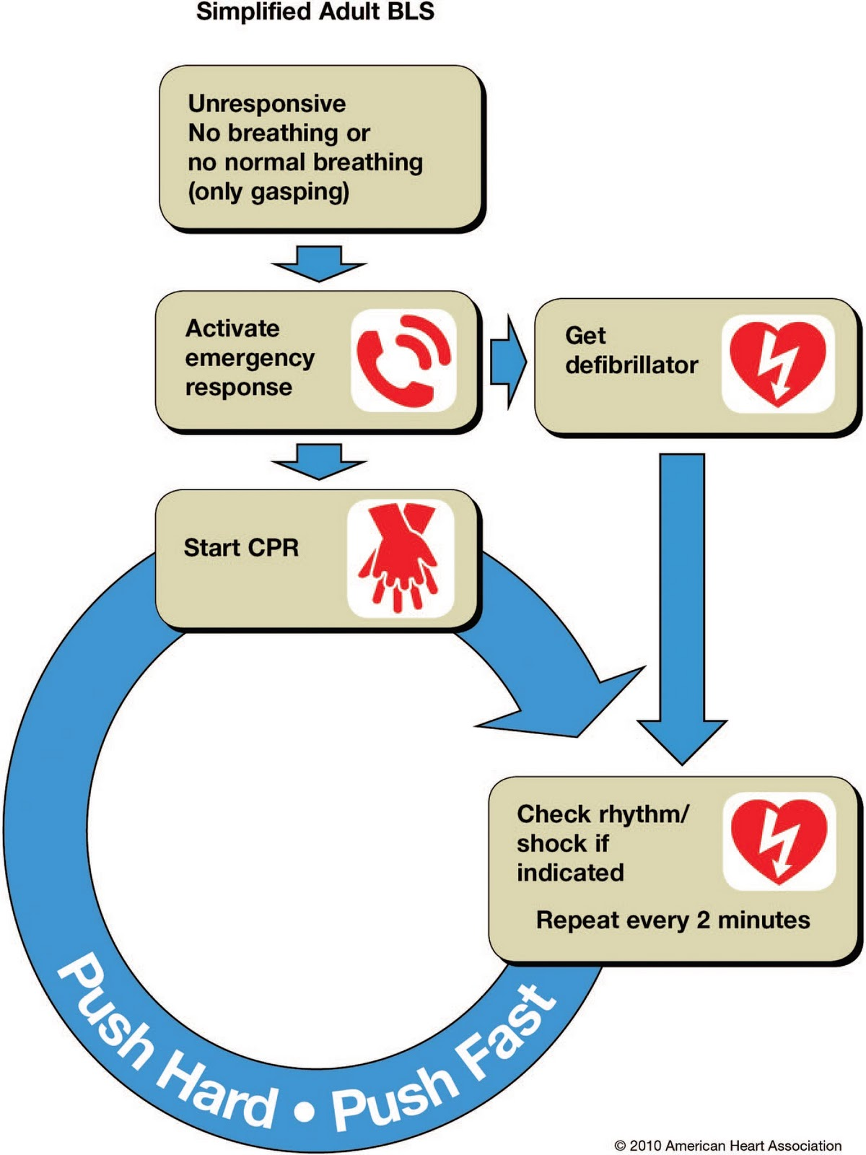
Cardiac Emergency Response Team Protocol
Recognize signs of SCA and take action.
Signs include: not moving, unresponsive, appears unconscious, appears to be having a seizure or convulsions
Facilitate immediate access to professional help.
Call 911, contact members of cardiac emergency response team, assign someone to meet EMS
Team members: retrieve AED, leave door open, proceed to location of emergency
Start CPR.
100-120 pumps/minute, 2-2.4” depth. Follow dispatcher instructions.
Use AED.
Use AED as soon as it becomes available. Press power on, attach pads, follow visual and voice instructions.
Transition care to EMS.

Slide 11
Communication of Plan
Post protocol:
In classrooms, cafeteria, restrooms, health room, faculty break room, school offices
Adjacent to each AED
Adjacent to each school telephone
In gym, swimming pool, other athletic locations
Distribute protocol to:
All staff and administrators, school nurse, athletic directors, coaches
Any organization using school

Slide 12
Training
Sufficient number of staff, including school nurse, should be trained in CPR and AED use to ensure plan can be carried out.
Recommended: 10% of staff, 50% of coaches, 50% of physical education staff
Training should include cognitive learning and hands-on practice.

Slide 13
Sample Letter to Parents
Announces school is among first in nation to adopt Cardiac Arrest Emergency Response Plan
Seeks support from parents to learn CPR and support CPR-AED program in school
Suggests parents may be called upon to participate in fundraising, training, and other tasks

Slide 14
Implementation Tool Kit and Suggested Timeline
Identify team members (July)
Ensure minimum number of AEDs needed (July)
Check and maintain each AED (beginning in July)
Post CERP plan throughout school (August)
Distribute CERP protocol to administration, faculty, athletic director, coaches, advisors, and throughout school (August)
Provide CPR/AED training for school staff including school nurse, teachers, athletic directors, coaches, and physical education staff (beginning in August)
Implement at least two CERP drills annually (October, March)
Coordinate regularly with local EMS on CERP (August)
Activate team (as needed)
Submit annual CERP evaluation (June)

Slide 15
Why CERPs Matter
Cardiac Emergency Response Plans for schools can mean the difference between life and death.
Here is living proof…

Slide 16
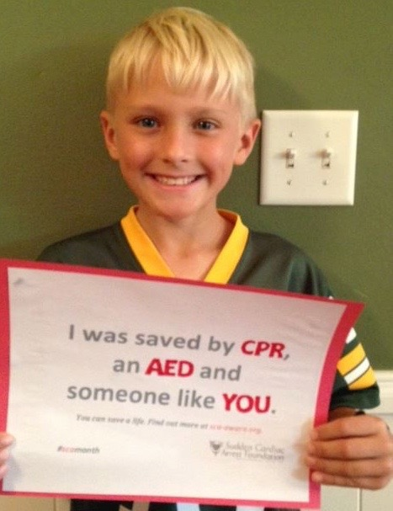
Jackson
Jackson, 7, was saved in gym class, thanks to actions of school nurse and gym teacher (2013).

Slide 17
Kaitlin
Kaitlin Forbes, 15, was saved by school staff and fellow students at Rhinebeck High School in Rhinebeck, NY
(2005)

Slide 18
Walter
Walter Watts, 21, was saved at College of the Ozarks, Point Lookout, MO, by professor and fellow students who were part of college EMS team (2012).

Slide 19
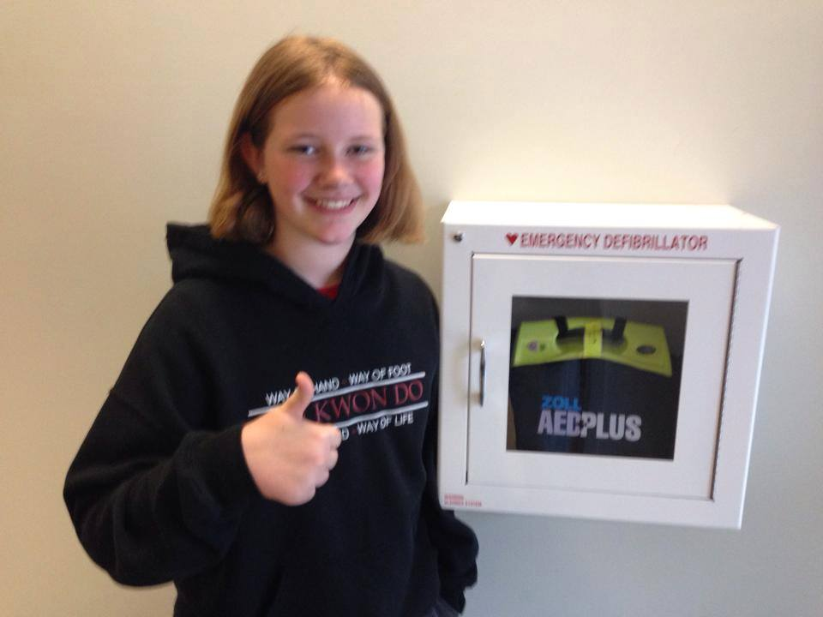
Olivia
Olivia Quigley, 6, was saved at East Boston Central Catholic School, East Boston, MA (2013).

Slide 20
Jacob
Jacob Vogt, 8, was saved by teacher Karen Rankin, at McGregor Reading and Math Preparatory School, Akron, OH (2015).

Slide 21
Jessica
Jessica Lemus, 12, was saved at Wisdom Lane Middle School in Levittown, NY (2015).

Slide 22
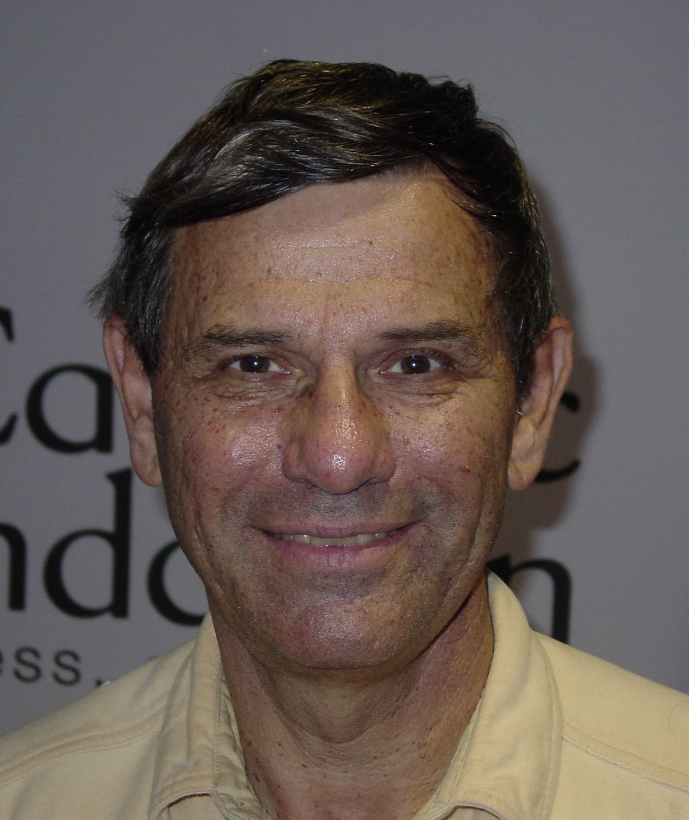
David
David Belkin, 65, was saved at Lakeside Elementary School in Honesdale, PA, by teammates in pick-up basketball game (2007).

Slide 23
Ellie
Ellie Whelan, 16, was saved by teacher and school nurse at Appomattox Regional Governor’s School for the Arts and Technology in Petersburg, VA (2013).

Slide 24
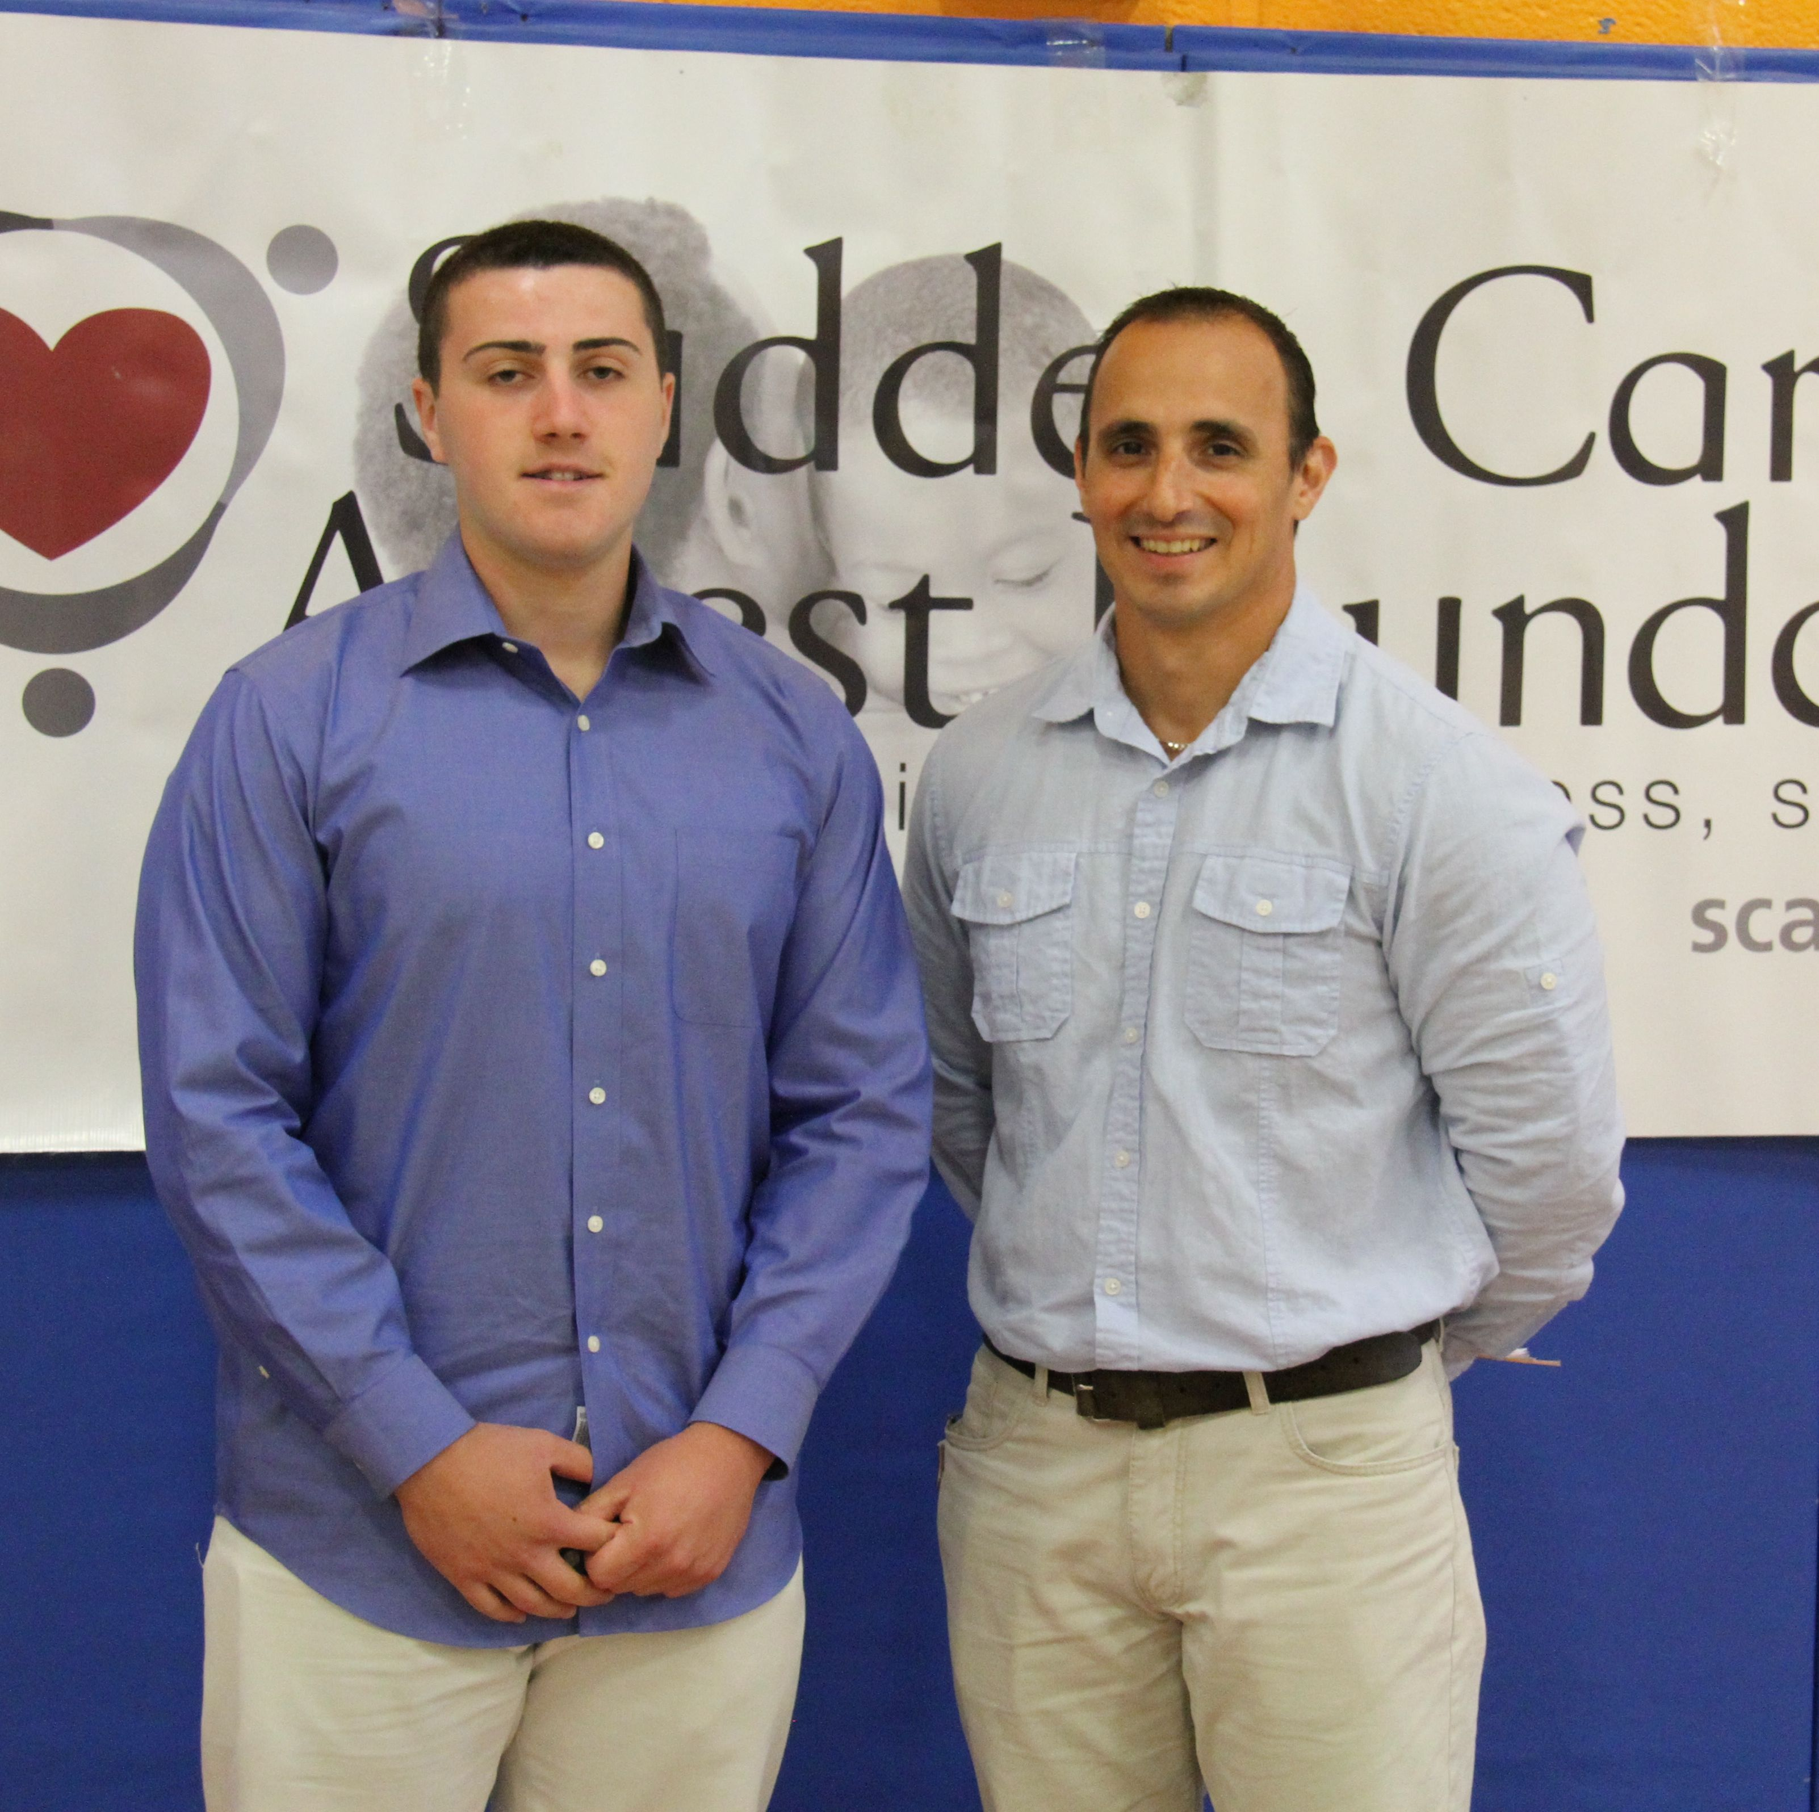
Anthony
Anthony Cortazzo, 15, was saved by athletic trainer, Steven Papa, at Pascack Hills High School in Montvale, NJ (2014).

Slide 25
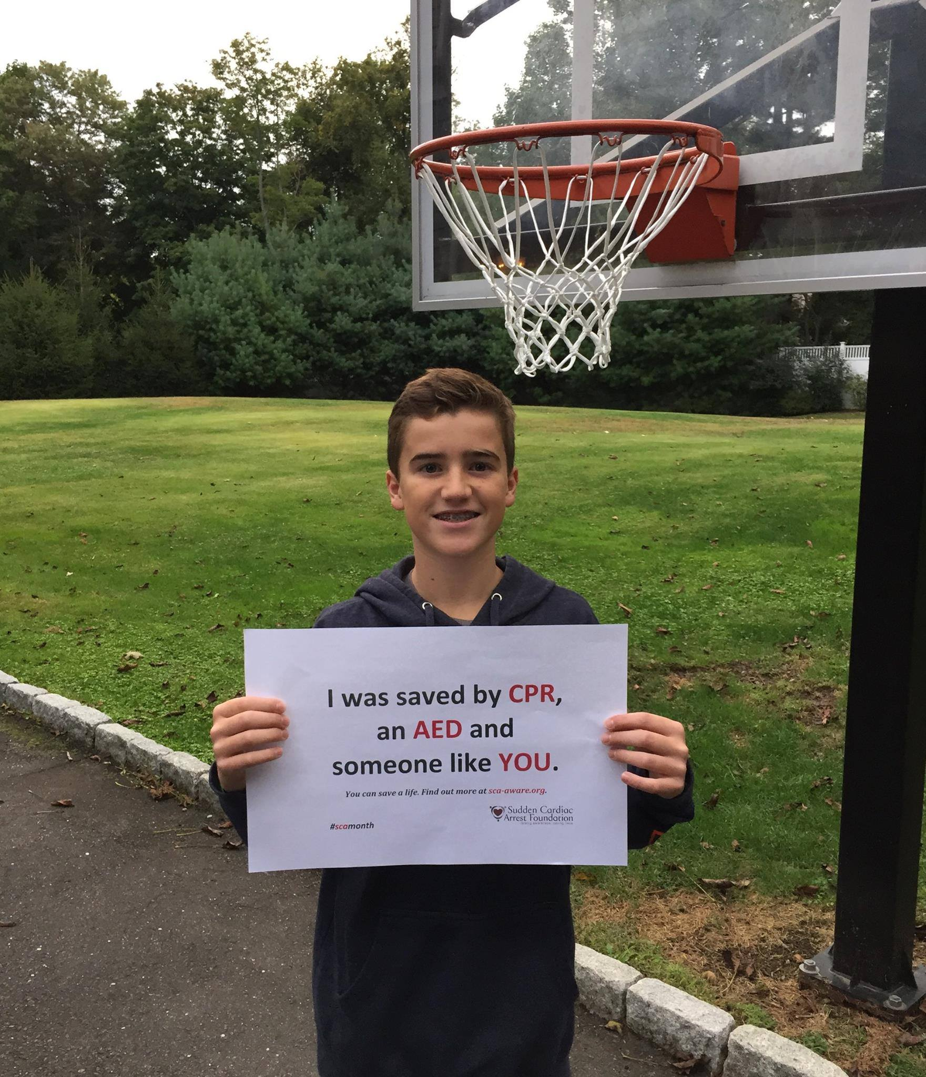
Adam
Adam Greenlee, Jr., 11, was saved by school staff and police officer at Bedford Middle School, Westport, CT (2014).

Slide 26
Kylee
Kylee Shea, 12, was saved by teachers Kristen Goodgion and Brent Reese at Maus Middle School in Frisco, TX (2011).

Slide 27
Erin and Sean
Teacher Erin Durborow was saved at Eisenhower Intermediate School in Bridgewater, NJ, by school nurse, Mary Ellen Urbanowicz (2013). Erin was pregnant with Sean, so two lives were saved that day.

Slide 28
For more information
www.heart.org/CERP
www.sca-aware.org/schools
mary.newman@sca-aware.org

